Slide 1
DHCP Reservations for SLAM Printers
The following procedures assume the SLAM print engine is configured to accept a DHCP address.

Slide 2
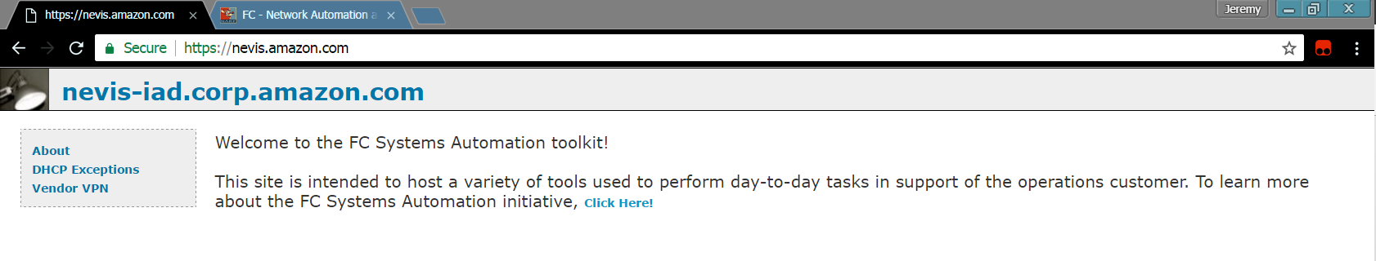
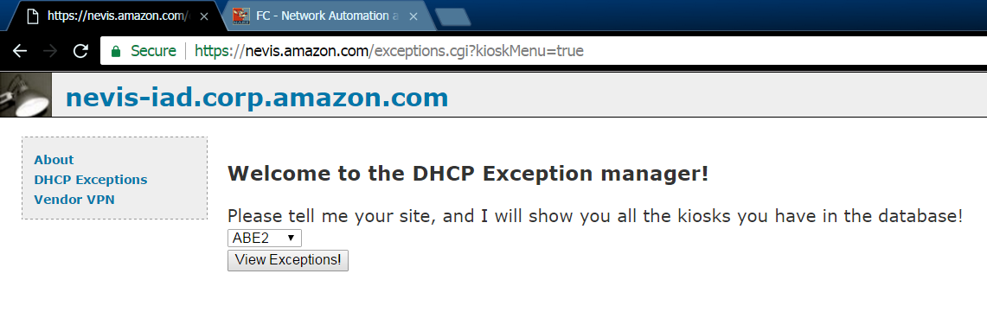
Locate and remove existing exceptions.
Browse to https://nevis.amazon.com/ and select “DHCP Exceptions” from the menu on the left of the page
From the resulting page, select your warehouse ID from the dropdown and click “View Exceptions”

Slide 3
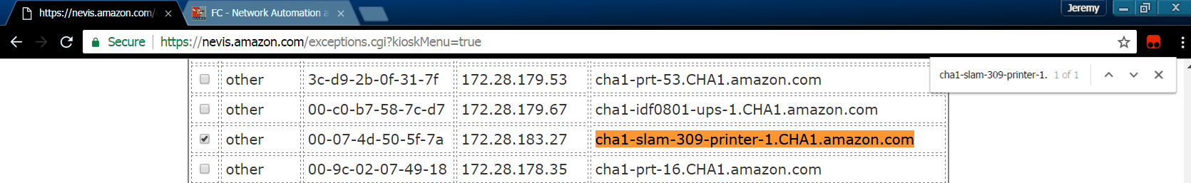
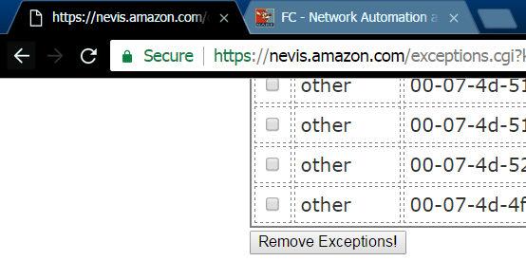
Locate and remove existing exceptions.
Search for the device you wish to manage by holding the ctrl key and pressing “f”. Type in the hostname of the device
you wish to manage
To remove the reservation, select the box on the left of the entry, scroll to the bottom of the list and click
“Remove Exceptions”.

Slide 4
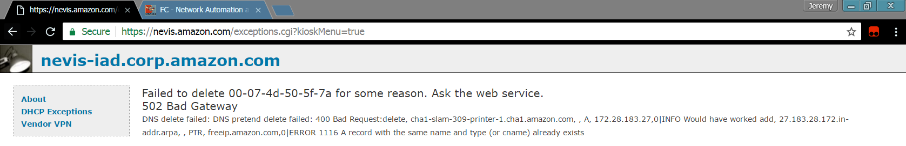
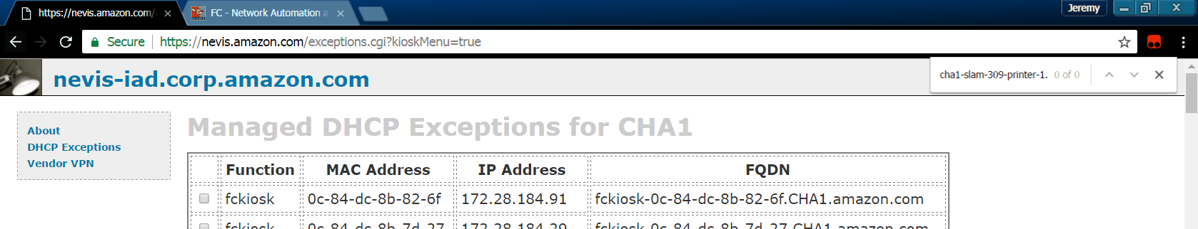
Locate and remove existing exceptions.
The delete operation may fail due to an existing DNS entry.
Regardless of the failure message, return to the exceptions list and verify the reservation was removed by searching
for the hostname again.

Slide 5
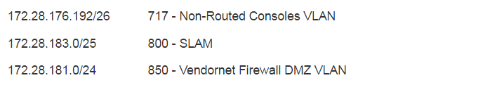
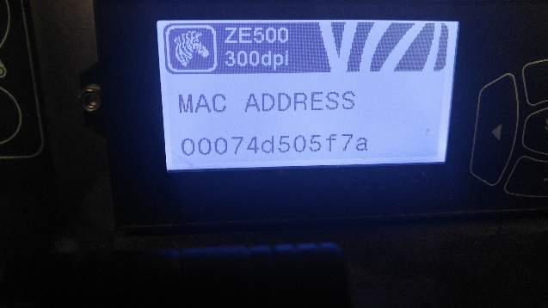
Add reservation.
Once the reservation has been removed, you can add a one for the new device. You must gather some information before
proceeding.
The MAC Address can be found in the menu of the printer.
The Subnet can be found in sigma. The url is https://sigma.amazon.com/WHID/network/ where whid is the warehouse ID. (i.e. CHA1 = https://sigma.amazon.com/CHA1/network/). Look for the ip address pattern for your SLAM printers. IF YOU NEED HELP, ASK IT. DON’T GUESS!!!!.

Slide 6
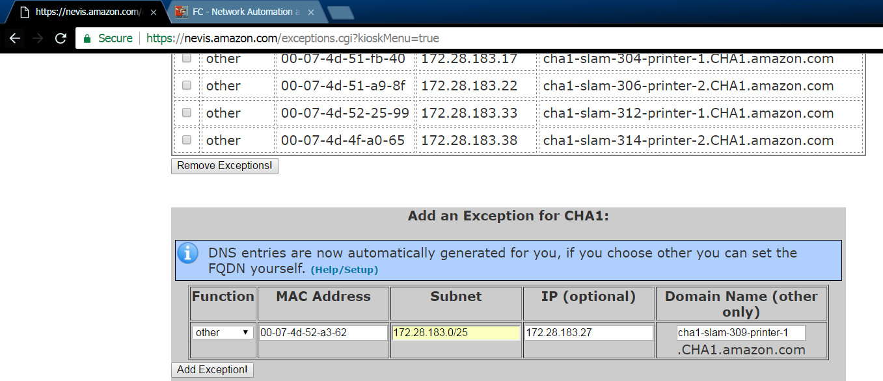
Add reservation.
Scroll to the bottom of the exceptions list and locate the “Add an Exception…” list. Enter the information as follows:
The “Function” will be “other”
The MAC Address you collected from the NEW device will be entered, separating pairs of digits with a hyphen “-”.
The Subnet will be entered EXACTLY as found in NARF. Do not include the VLAN name or alias.
The Domain Name will be the hostname for the printer WITHOUT .whid.amazon.com at the end.
See https://dns-manage-web.amazon.com/ if you need to verify the hostname.
DOUBLE CHECK ALL INFORMATION WAS ENTERED CORRECTLY.
Click “Add Exception!” to complete.

Slide 7
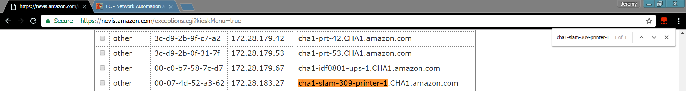
Add reservation.
Navigate back to the listing and verify that the exception was added. Use ctrl + f to search for the hostname.
Verify the MAC Address and IP are correct.
It will take between 5 and 15 minutes for the reservation to populate to the device.

Slide 8
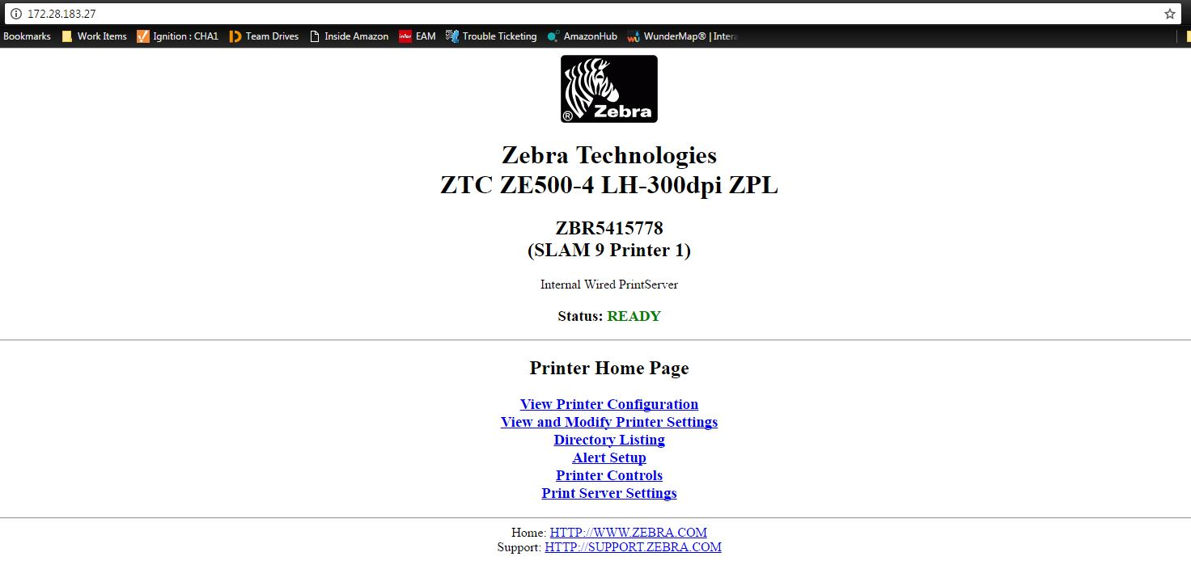
Base Raw Port
Once you’ve added your exception to Nevis, you’ll want to make sure your base raw port is set for the printer to connect.
First you’ll want to navigate to a web browser and type in the IP into the address bar. This will bring you to the printer’s home page.

Slide 9
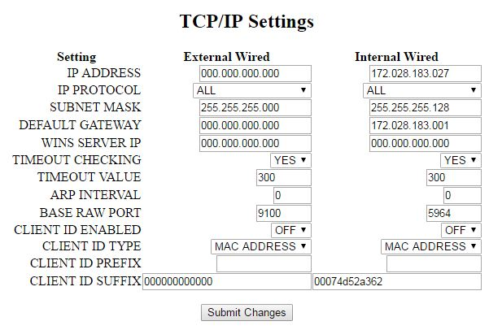
Base Raw Port
Click on View and Modify Printer Settings.
Enter Password: 1234
Click Network Configuration
Click TCP/IP Settings
Verify Base Raw Port is set to 5964 (Internal Wired). It will sometimes revert to 9100, if so you’ll need to change it.

Slide 10
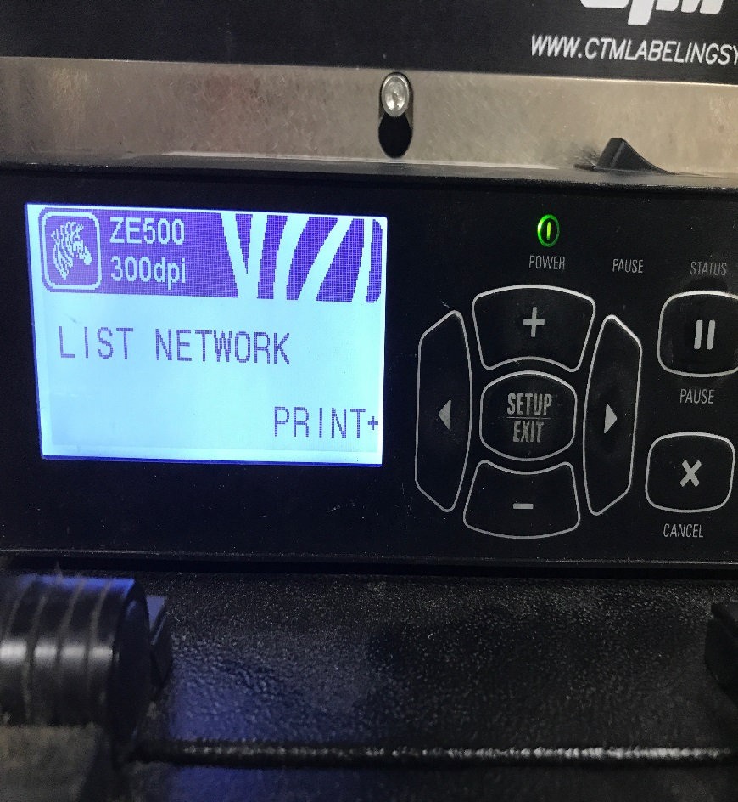
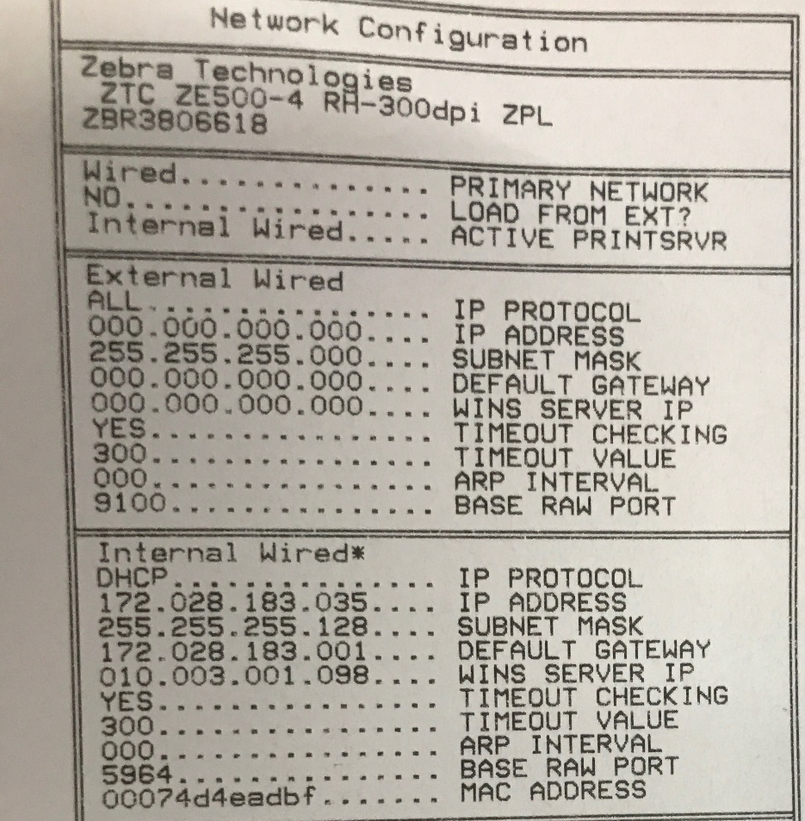
Base Raw Port
You can also check the settings from the printer to verify if it’s correct.
Go into the printer settings and navigate to the List Network tab and press the + button.
Look at the label to see if the Base Raw Port is correct.

